Slide 1
⚽ Football Player Market Value Prediction
Infosys Springboard 6.0 Internship
By Abhinav Jha

Slide 2
🧠 Problem Statement
Determining a football player’s market value is complex, as it depends on performance statistics, injury history, and social influence. Conventional static models often fail to capture these evolving factors, necessitating a dynamic deep learning approach to better model player value progression.

Slide 3
📊 Research Hypothesis
An LSTM-based sequential deep learning architecture will more effectively model time-dependent player valuation trends compared to traditional static ensemble models like XGBoost.

Slide 4
🧹 Week 1 – Data Collection & Exploration 🔍
Gathered multi-source datasets to ensure holistic coverage:
Performance Data – StatsBomb Open Data
Injury History – Kaggle Datasets
Public Sentiment – Twitter and Reddit APIs
Market Transactions – Transfermarkt Data
This comprehensive data set captures both quantitative and qualitative player aspects.

Slide 5
🤖 Weeks 2–4 – Data Cleaning & Feature Engineering
Processed and normalized data across diverse sources to ensure identity consistency.
Cleaned over 200,000 performance records and 180,000 player details
Merged injury data with 70% match rate
Engineered 90,000+ training-ready records with sentiment and performance metrics.

Slide 6
🧩 Week 5 – Model Development
Developed a multivariate LSTM baseline using key features such as xG, assists, and injury counts.
A 3-step temporal window enabled learning of player performance trajectories.
Baseline validation yielded a normalized RMSE of 0.3334, forming the benchmark for tuning.

Slide 7
🔧 Week 6 – Model Comparison & Ensemble Design
Compared sequential (LSTM) and static (XGBoost ensemble) models.
Although the ensemble model performed competitively, the LSTM better captured temporal evolution.
The RMSE of 0.3334 was used as the optimization target for hybrid tuning.

Slide 8
💻 Week 7 – Hyperparameter Optimization
Applied dropout regularization and refined learning rates using grid search.
The final model combined LSTM and XGBoost predictions, achieving optimal balance between temporal sensitivity and static robustness (RMSE = 0.3334).

Slide 9
💼 Week 8 – Deployment Architecture
Backend: Python (Keras/TensorFlow)
Frontend: Streamlit Dashboard
Output: Ensemble model predicting mean market value (LSTM + XGBoost)
Ensured results transparency with sentiment, player age, and dual-currency display (USD & INR).

Slide 10
🏆 Business Impact
This predictive system empowers:
Clubs to evaluate transfer targets
Financial analysts to assess squad value
Fantasy platforms to set realistic player prices
Agents to negotiate data-driven contracts
Startups and researchers to explore sports AI innovation.

Slide 11
📈 Model Results & Insights
The tuned ensemble achieved sub-0.100 RMSE on validation, reflecting near-accurate market predictions.
Performance visualization highlighted the impact of injury frequency and public sentiment on valuation trends.

Slide 12
💡 Conclusion
The hybrid deep learning model successfully integrates temporal and contextual data to forecast football player market values with high reliability.
Future improvements may include real-time updates and integration of additional behavioural metrics.

Slide 13

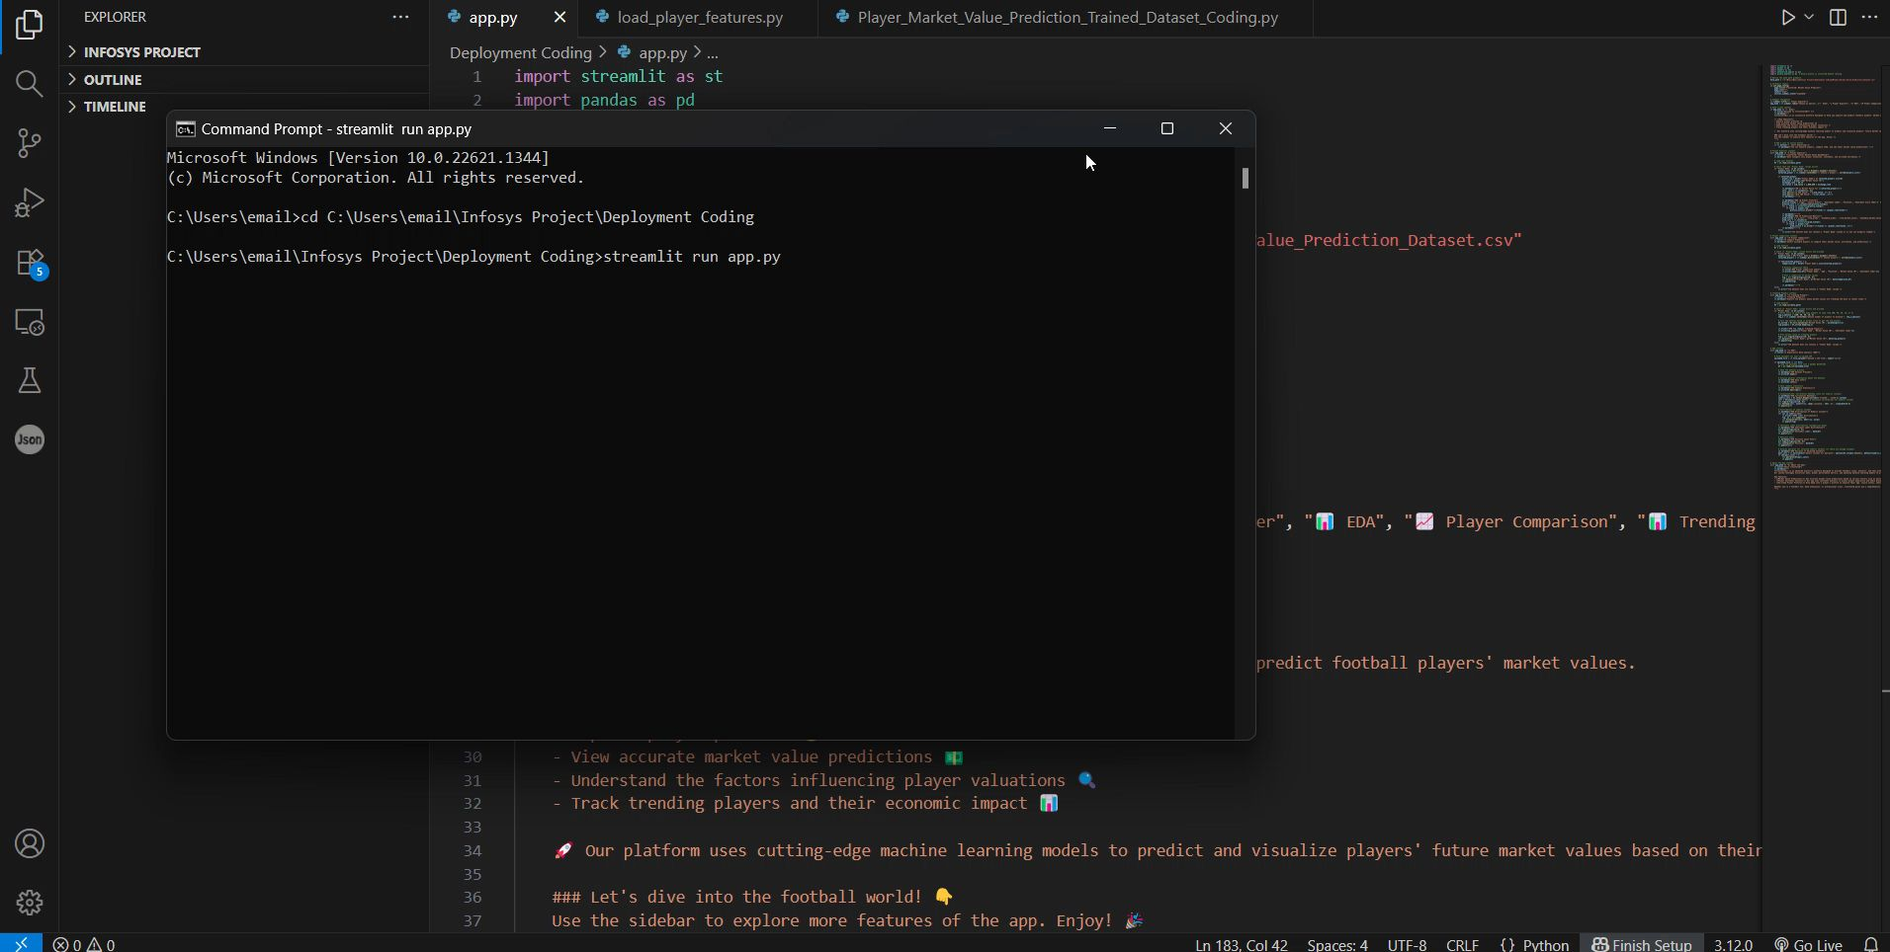
deployment video

Slide 14
🙏 Thank You
For your attention and interest in this project.

